Slide 1
SQL PREPARATION DAY:3 Some examples
Topics: MANJYNAIK V D
(Data Analyst)
1.Having
2.WHERE
3.ORDER BY
4.GROUP BY
5.HAVING
6.AGGREGATE FUNCTIONS

Slide 2
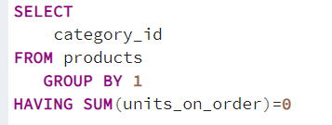
1.list the categories which don’t have units on order.

Slide 3
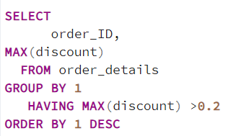
2.get a list of order_id in which any of the products have been discounted by more than 20%.

Slide 4
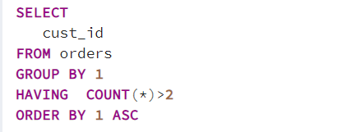
3.Find customers who appear in the orders table more than two times.

Slide 5
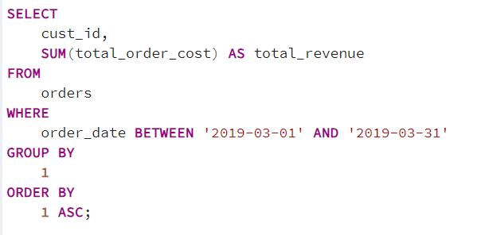
4.Calculate the total revenue from each customer in March 2019. Include only customers who were active in March 2019.

Slide 6
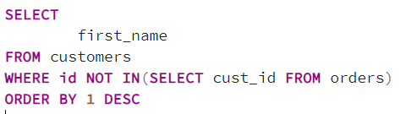
5.Find customers who have never made an order. Output the first name of the customer.

Slide 7
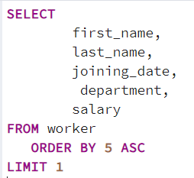
6.Find the details of worker with the least salary without using MIN function.

Slide 8
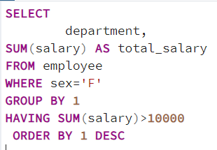
7.Find the departments where the total salary (sum of salary) of female employees is greater than 10000

Slide 9
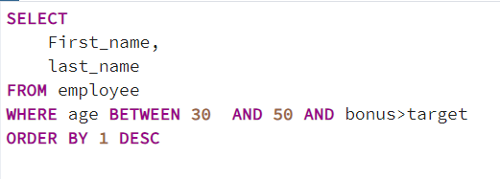
8.Find employees whose first name end with 'm' or 'n’.

